Slide 1
أكـــــاديميــــة طــــويـــق
Deep Learning

Slide 2
Deep Learning Frameworks
By: Dr. Afshan Hashmi

Slide 3
Course Objectives:
Understand what deep learning frameworks are and why they are important.
Compare TensorFlow and PyTorch, two of the most popular DL frameworks.
Set up and run deep learning experiments in Google Colab and Jupyter Notebook.
Write basic neural network models using TensorFlow and PyTorch.

Slide 4
Introduction to Deep Learning Frameworks
What Are Deep Learning Frameworks?
Deep learning frameworks are software libraries that provide the essential tools, functions, and pre-built components needed to:
Design neural network architectures
Train models on large datasets
Validate performance
Optimize the learning process
These frameworks simplify complex tasks like:
GPU programming (leveraging hardware for faster training)
Parallelization (distributing work across CPUs/GPUs)
Mathematical operations (like matrix multiplications, derivatives)
Goal: Allow researchers and developers to focus on the model and data, not low-level implementation details.

Slide 5
Popular Deep Learning Frameworks
Framework | Developed By | Key Features
TensorFlow | Google | Scalable, production-ready, strong ecosystem (TensorBoard, TFX, etc.)
PyTorch | Meta (Facebook) | Dynamic computation graph, beginner-friendly, widely used in research
Keras | Integrated in TF | High-level API for TensorFlow, great for rapid model development
MXNet | Apache | Supports multiple languages, efficient for large-scale deployment
CNTK | Microsoft | Designed for production-level performance (now less commonly used)
JAX | Google | For high-performance numerical computing and automatic differentiation

Slide 6
Why Use Them?
Rapid Prototyping – Build and test ideas quickly
Efficient Training – Leverage hardware acceleration
Reusable Components – Layers, optimizers, loss functions, etc.
Easy Debugging & Visualization – Especially with tools like TensorBoard or Weights & Biases
Without Framework | With Framework (PyTorch/TensorFlow)
Manual backpropagation | Automatic differentiation (autograd)
CUDA coding for GPU | Single-line GPU transfer (.to('cuda'))
No prebuilt layers | 100+ layers (LSTM, Conv2D) ready-to-use

Slide 7
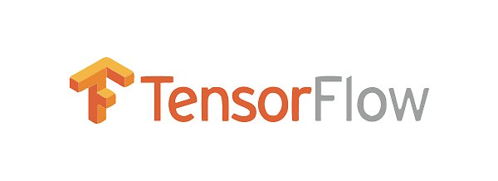
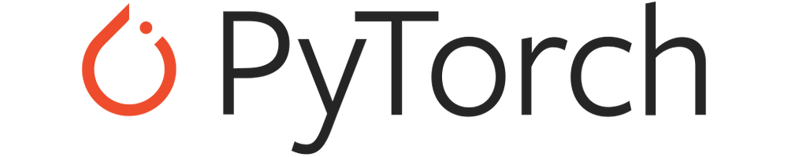
Popular Framework
TensorFlow and PyTorch are two of the most popular and powerful open-source machine learning frameworks. They provide comprehensive ecosystems for building, training, and deploying various machine learning models, including deep learning networks. While they share the ultimate goal of enabling machine learning, they have distinct characteristics in terms of their design philosophy, ease of use, and community.

Slide 8
Introduction to TensorFlow
What is TensorFlow?
TensorFlow is an open-source deep learning framework developed by Google Brain.It’s one of the most widely-used libraries for building and training machine learning and deep learning models.
Primary Language: Python, with C++ for performance-critical operations.
Key Features and Concepts:
Static Computational Graphs: TensorFlow 1.x heavily relied on defining the entire computational graph symbolically before execution. This graph represents the flow of data through the model's operations. While this approach allowed for optimizations and deployment to various platforms, it could be less intuitive for debugging and experimentation.
Eager Execution (TensorFlow 2.x): Introduced in TensorFlow 2.x, eager execution provides an imperative, Pythonic way of running operations immediately as they are defined, making debugging and development more straightforward. TensorFlow 2.x has become the default and strongly encouraged mode.

Slide 9
Introduction to TensorFlow
Keras API: TensorFlow integrates Keras as its high-level API, providing a user-friendly interface for building and training neural networks. Keras simplifies common tasks and makes TensorFlow more accessible to beginners.
TensorBoard: A powerful visualization toolkit for monitoring and debugging machine learning experiments. It allows you to track metrics, visualize model graphs, inspect weights and biases, and more.
TensorFlow Extended (TFX): A production-ready machine learning platform for deploying and managing TensorFlow models at scale.
Wide Deployment Options: TensorFlow supports deployment across various platforms, including CPUs, GPUs, TPUs (Tensor Processing Units - Google's custom AI accelerators), mobile devices, and web browsers (TensorFlow.js).
Large and Mature Ecosystem: TensorFlow has a vast and well-established community, extensive documentation, and a wide range of pre-trained models and tools.

Slide 10
Strength & Weakness of TensorFlow
Strengths:
Production Readiness: TensorFlow has a strong focus on deployment and scalability, making it a popular choice for industrial applications.
Mature Ecosystem and Community: Its large community provides ample support, tutorials, and pre-built solutions.
Powerful Tools for Deployment and Monitoring: Tools like TFX and TensorBoard are invaluable for managing the entire ML lifecycle.
Strong Support for TPUs: TensorFlow is well-optimized for Google's TPUs, offering significant performance benefits for large-scale training.
Weaknesses:
Steeper Learning Curve (Historically): The static graph approach in earlier versions could be challenging for beginners to grasp.
Debugging Complexity (Historically): Debugging static graphs could sometimes be less intuitive than with eager execution.

Slide 11
Core Concepts:
Concept | Explanation
Tensors | Multidimensional arrays (like NumPy arrays) that are the basic data structure in TensorFlow. All input data and model parameters are represented as tensors.
Computational Graph | A model is defined as a graph of operations (nodes) where each node represents a mathematical computation. This graph can then be executed efficiently on different hardware.
Sessions (TF 1.x) | A Session was used to execute the computational graph. You first define the graph, then run it in a session.
Eager Execution (TF 2.x) | Now the default in TensorFlow 2.x allows operations to run immediately (like regular Python code), making development and debugging much easier.

Slide 12
Introduction to PyTorch
What is PyTorch?
PyTorch is an open-source deep learning framework developed by Meta AI (Facebook). It is designed to be flexible, intuitive, and Pythonic, making it especially popular in research and academia.
Primary Language: Python, with C++ for performance-critical operations.
Key Features and Concepts:
Dynamic Computational Graphs: PyTorch builds computational graphs on the fly as operations are executed. This "define-by-run" approach offers greater flexibility and makes debugging more intuitive, as you can inspect intermediate values easily.
Pythonic and Intuitive: PyTorch is known for its Python-friendly API, which feels very natural for Python developers. Its syntax is often considered more straightforward and easier to learn than earlier versions of TensorFlow.

Slide 13
Introduction to PyTorch
Strong GPU Acceleration: PyTorch has excellent support for NVIDIA GPUs, making it efficient for training deep learning models.
Large Ecosystem and Growing Community: PyTorch has a rapidly growing and active community, with a wealth of tutorials, libraries (like PyTorch Lightning and Hugging Face Transformers), and research implementations.
Focus on Research and Flexibility: PyTorch is widely adopted in the research community due to its flexibility and ease of experimentation.
TorchScript: Allows you to serialize PyTorch models and run them in production environments, often without the Python dependency, bridging the gap between research and deployment.

Slide 14
Strength & Weakness of PyTorch
Strengths:
Ease of Use and Learning: Its Pythonic nature and dynamic graphs make it generally easier for beginners and researchers to pick up.
Excellent for Research and Experimentation: The flexibility of dynamic graphs facilitates rapid prototyping and exploration of new model architectures.
Strong GPU Performance: PyTorch is highly optimized for GPU acceleration.
Growing Community and Ecosystem: The PyTorch ecosystem is vibrant and expanding rapidly.
Weaknesses:
Production Deployment (Historically): While PyTorch has made significant strides with TorchScript and integration with cloud platforms, it was historically perceived as less mature for large-scale production deployment compared to TensorFlow. This gap is narrowing.
TPU Support (Historically): While support for TPUs exists, it has traditionally been less mature than in TensorFlow.

Slide 15
Key Features of PyTorch
Feature | Description
Tensors | Core data structure (like NumPy arrays but with GPU support)
Autograd | Automatically computes gradients for training neural networks using backpropagation
Modules | Everything in PyTorch is an object-oriented module; models can be built by extending nn.Module
Sequential Models | Easy way to stack layers in order using nn.Sequential
DataLoader | Built-in tool for efficiently loading, shuffling, and batching data for training/testing
Where is PyTorch Used?
Academia & Research: Due to its flexibility and ease of use.
Industry: Now also used in production environments (with tools like TorchServe and ONNX).

Slide 16
TensorFlow vs. PyTorch
Feature | TensorFlow | PyTorch
Graph Type | Primarily Dynamic | Dynamic
Execution Mode | Eager by default | Define-by-run
Ease of Use | Improved significantly with Keras | Generally considered more Pythonic and intuitive
Debugging | More straightforward with Eager | More straightforward due to dynamic graphs
Research Focus | Growing adoption | Historically stronger
Production Focus | Strong, mature ecosystem | Growing, with tools like TorchScript
Community Size | Very large and mature | Large and rapidly growing
GPU Support | Excellent | Excellent
TPU Support | Strong, well-established | Available, but historically less mature
High-Level API | Keras (integrated) | Often relies on external libraries (e.g., PyTorch Lightning)

Slide 17
TensorFlow vs. PyTorch
Comparison Table
Feature | TensorFlow | PyTorch
Developed By | Google | Meta (Facebook)
Graph Type | Static (earlier) → Dynamic (TF 2.x+) | Dynamic (eager execution)
Syntax | Keras (high-level) + TF ops | Pythonic, imperative
Deployment | Strong (TF Lite, TF Serving) | Growing (TorchScript, ONNX)
Research Use | 40% papers (2020) | 60% papers (2023)

Slide 18
Which one should you choose?
The best choice depends on your specific needs and priorities:
For Beginners and Researchers: PyTorch's ease of use, intuitive API, and dynamic graphs often make it a preferred choice for learning and experimentation.
For Production Deployment and Large-Scale Industrial Applications: TensorFlow's mature ecosystem, strong deployment tools (TFX), and robust support for TPUs can be advantageous.
If you prefer a highly integrated and comprehensive framework: TensorFlow, especially with Keras, offers a complete solution within a single ecosystem.
If you value Pythonic simplicity and flexibility: PyTorch's design aligns well with Python development practices.
In reality, the lines between the two frameworks have blurred significantly in recent years. TensorFlow 2.x has adopted eager execution, making it more dynamic and easier to use. PyTorch has made significant progress in production deployment capabilities. Many researchers and practitioners are becoming proficient in both frameworks, leveraging their respective strengths for different tasks.

Slide 19
Setting Up the Environment
Option 1: Google Colab (Recommended)
Steps:
Go to colab.research.google.com
Click New Notebook
Verify GPU:
!nvidia-smi # Check GPU
import tensorflow as tf
tf.test.gpu_device_name() # Verify TF GPU access
Pros:
Free GPU (T4/K80)
No setup required

Slide 20
Setting Up the Environment
Option 2: Local Jupyter Notebook
Installation:
# Create conda environment
conda create -n dl_env python=3.8
conda activate dl_env
# Install frameworks
pip install tensorflow torch jupyterlab
Launch:
jupyter lab # Opens browser-based IDE

Slide 21
Key Concepts of TensorFlow Illustrated:
Tensors: The fundamental data structure in TensorFlow, representing multi-dimensional arrays.
Operations: Functions that manipulate tensors.
Computational Graph (Implicit with Eager Execution): While TensorFlow 2.x defaults to eager execution (running operations immediately), it still builds an underlying computational graph for optimization during training and deployment.
Layers: Building blocks of neural networks.
Models: Collections of layers that define the network's architecture.
Training: The process of adjusting the model's parameters to minimize the loss function on the training data.
Evaluation: Assessing the trained model's performance on unseen data.
This is just a glimpse into the capabilities of TensorFlow. It's a powerful framework used for a wide range of machine learning tasks, from image recognition and natural language processing to time series analysis and reinforcement learning.

Slide 22
Key Concepts of PyTorch Illustrated:
Tensors: The fundamental data structure.
torch.nn.Module: The building block for creating neural networks.
Layers: Pre-defined neural network layers in torch.nn.
forward method: Defines how data flows through the network.
Loss Function: Measures the discrepancy between the model's predictions and the actual targets.
Optimizer: Updates the model's parameters to minimize the loss.
Backpropagation: The process of computing gradients.
Eager Execution (Implicit): PyTorch operates with dynamic computational graphs, meaning the graph is built on the fly as operations are executed, making debugging and experimentation more straightforward.

Slide 23

Summary
TensorFlow and PyTorch are powerful, flexible deep learning libraries.
TensorFlow is more structured; PyTorch offers more flexibility.
Google Colab is ideal for quick experiments; Jupyter Notebook gives local control.
Hands-on coding is the best way to learn deep learning frameworks

Slide 24
Practice with Google COLAB
Click here https://drive.google.com/file/d/1GqPC0dfghOKGOx55MBfk1g5NCVvOIUYv/view?usp=share_link

Slide 25
Books and References
TensorFlow Documentation
PyTorch Tutorials
Deep Learning with Python - François Chollet
Programming PyTorch for Deep Learning - Ian Pointer
Fast.ai Deep Learning Course

Slide 26
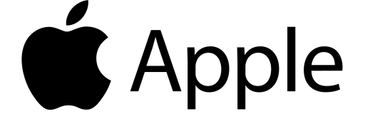

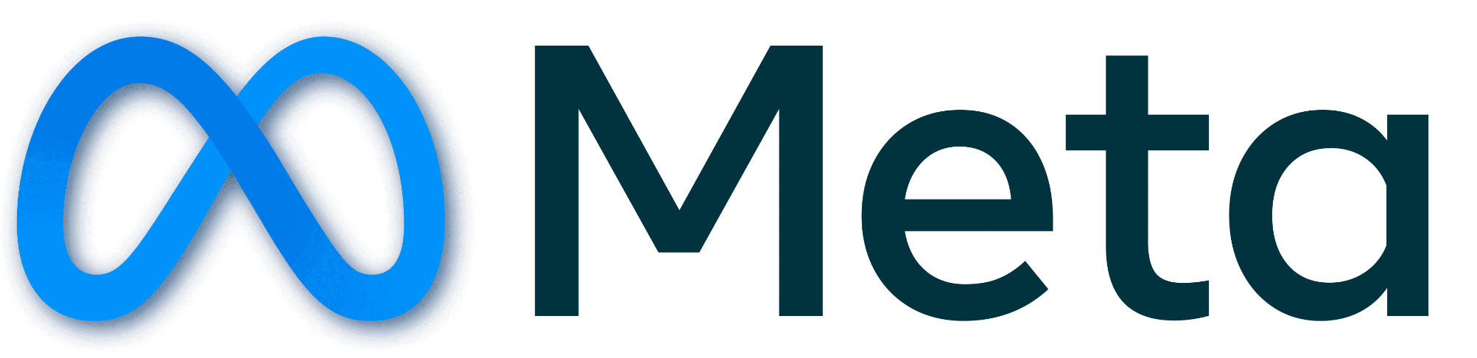














الشراكات العالمية

Slide 27
شــــــكــــرًا لكــــــم
THANK YOU

